Slide 1
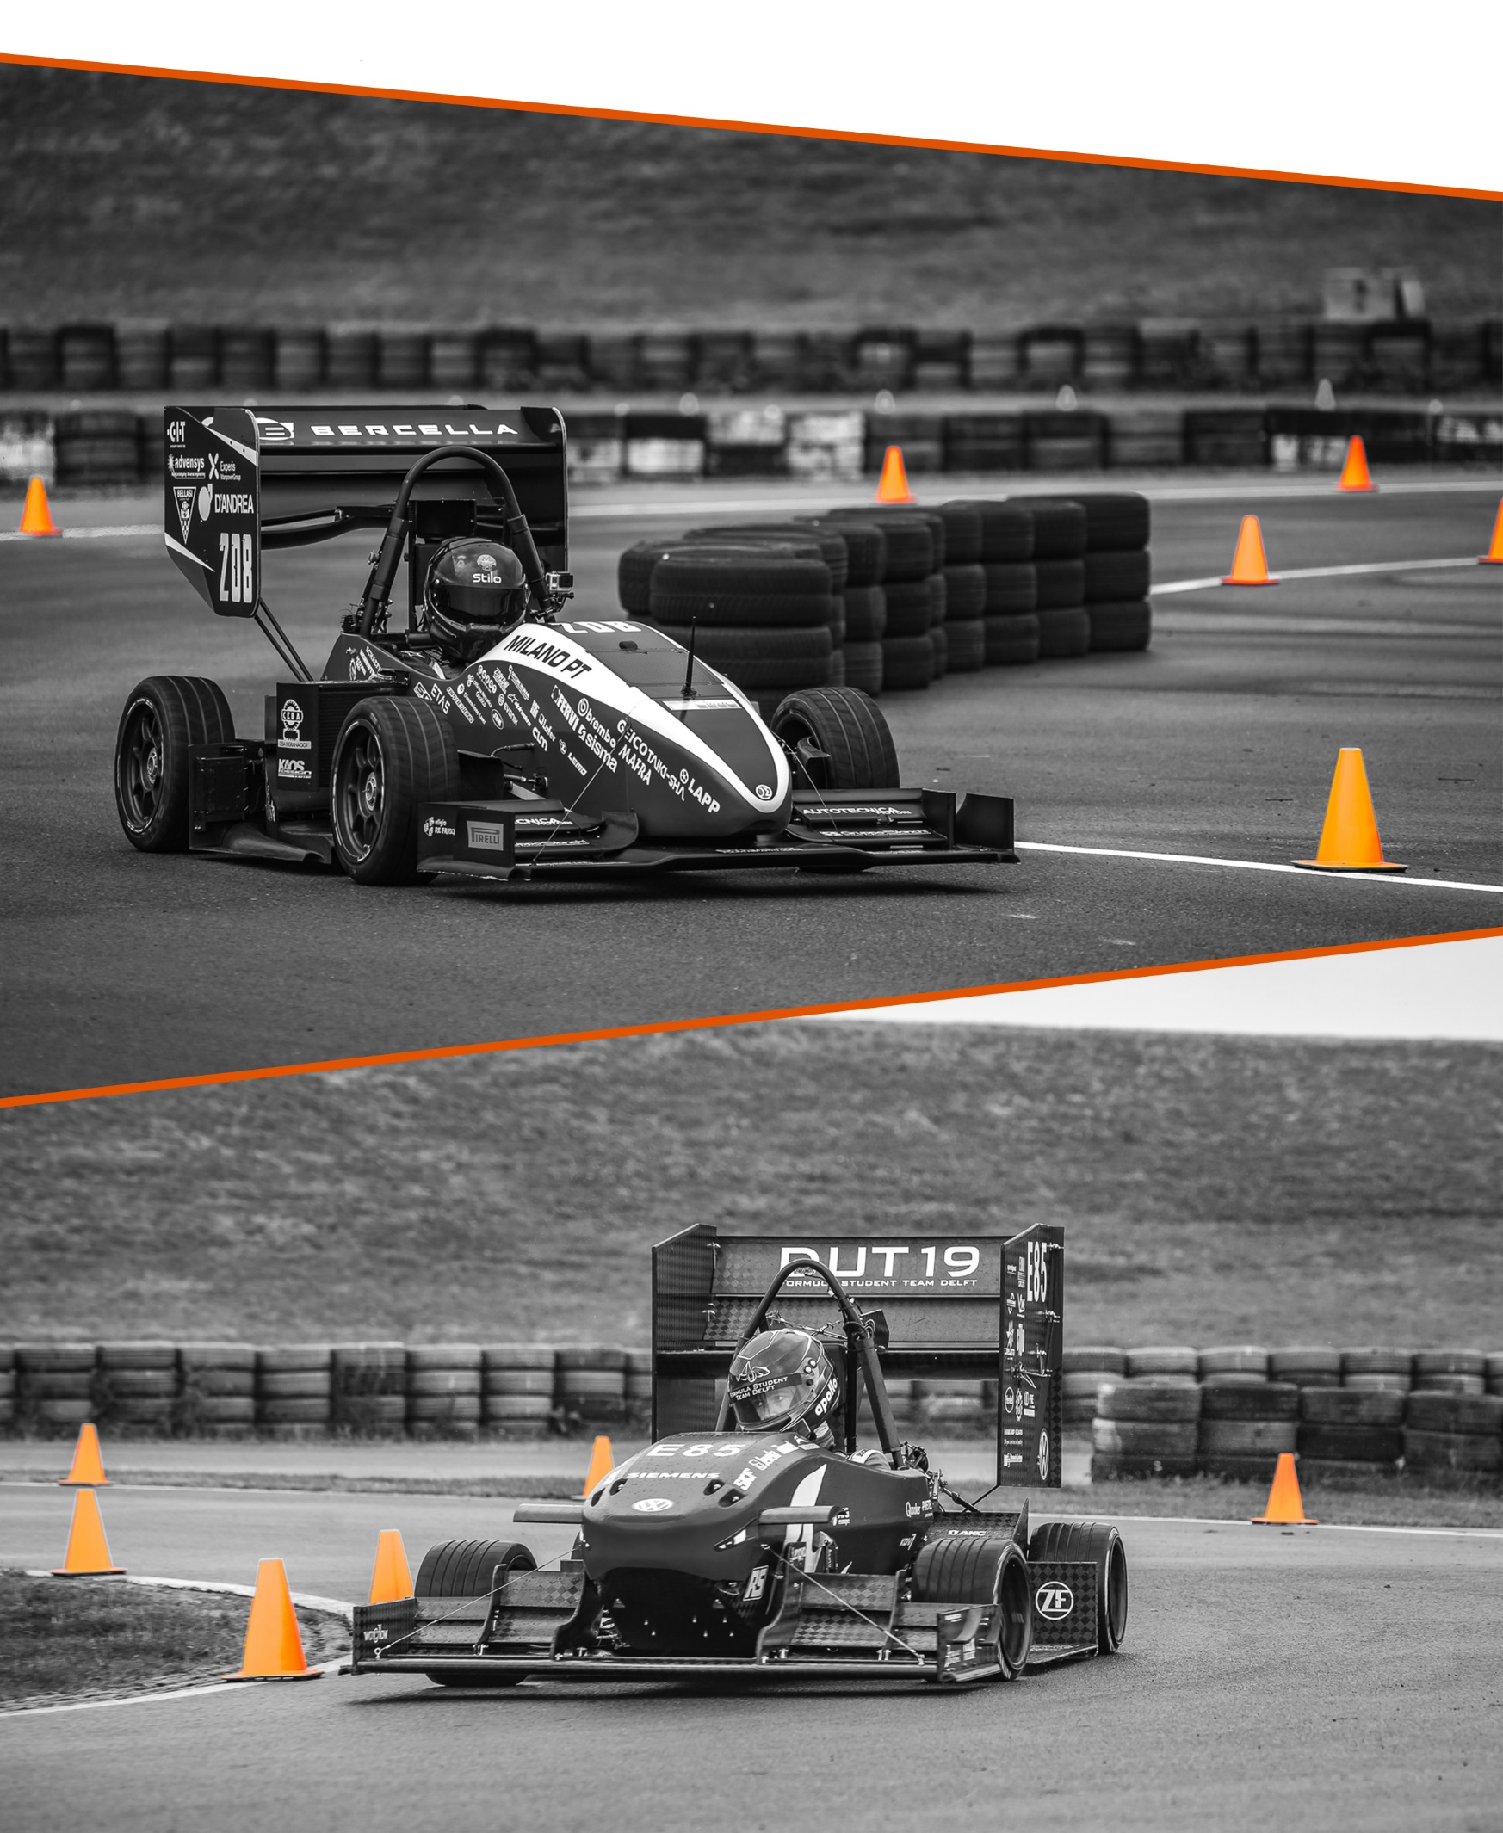
FORMULA STUDENT NETHERLANDS
TEAM MANAGER MEETING WEDNESDAY
JULY 7th 2021 | 08:30 CEST

Slide 2
TODAY (General)
Garage doors open from 08:45, unless instructed otherwise

Slide 3
TODAY (Scrutineering)
09:00-12:00 All inspections
After lunch: on appointment
In any case, no noise and brake test after 19:00

Slide 4
TODAY (Statics)
C&M Stage 3
Congratulations to Stage 3 C&M Event finalists:
CV: 181, 270, 373, 395
EV: E57, E85
Cost Finals will take place at the Techno Centre . Seats and tables are provided.
Schedule is as follows:
19.00 – 19:45 E57 (UPC Barcelona) and 181 (EC Lyon)
19:45 – 20:30 E85 (TU Delft) and 395 (TU Valencia)
20:30 – 21:15 373 (UC3M Leganés) and 270 (UAS Coburg)
Teams are allowed to bring:
- All cost report related documentation
- Pen/markers, paper/flip overs boards, laptop with full batteries and manual calculators.
- No internet allowed on mobile devices during judging, save any information you think you will need on your laptop to be accessed offline.

Slide 5
TODAY (Dynamics)
Pick up transponders at the welcome centre. See the technical directive regarding placement
Practice Area open from 09:00-18:00
If there is a queue, 5 minutes per team. Allowed to requeue.
Skid Pad Event (Wednesday): 09:00-12:30
Acceleration Event: 10:00-19:00
Autocross Event: 13:30-19:00
Livestream on YouTube (Formula Student Netherlands)
Livetiming via MyLaps Speedhive App

Slide 6
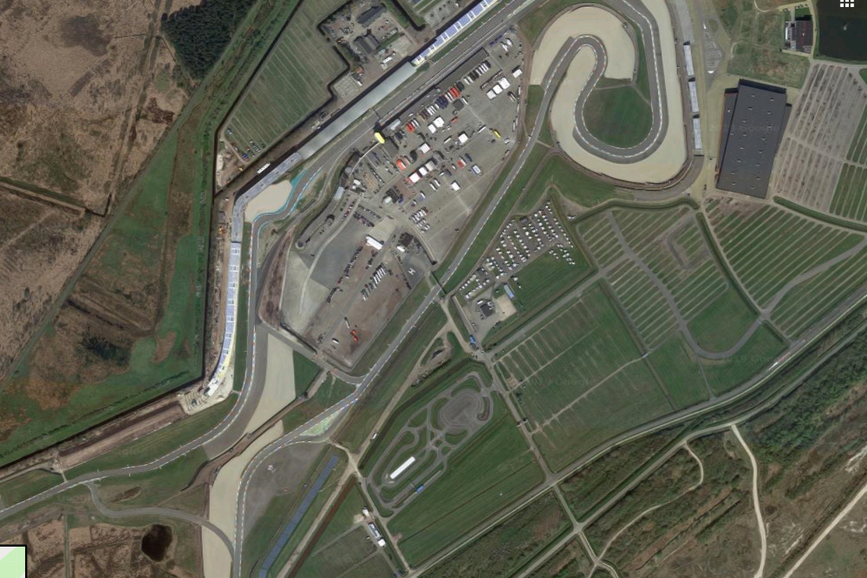
TODAY (Dynamics)
Pit Garages
Pick up transponders from 11:00 at the welcome centre.
Deposit is included in Registration Deposit.
Collecting transponder only allowed after passing brake test.
Please remember to return transponder after endurance on Thursday.
Practice Area open from 09:00-18:00
If there is a queue, 5 minutes per team. Allowed to requeue.
2 Solar Cars on track for filming purposes between 09:00-14:00
Driver Briefing in Media Centre at 12:00
Skid Pad Event (Tuesday): 15:00-19:00
Don’t queue before 14:45
Livestream on YouTube (Formula Student Netherlands)
Livetiming via MyLaps Speedhive App
Scrutineeirng
Autocross
Skid Pad
Practice Area

Slide 7
TODAY (Event Photo & Liveshow)
Bring your cars your cars to the main straight from 19:30
Max 1 driver + 2 people to push car (any member) + 2 wing people for cars with aero devices
Event Photo will be taken with cars only, unfortunately no team members this year
Park car on instruction of officials
After the event photo has been taken, you are allowed to take team photo’s on the main straight and the GT Chicane (including team members). Masks on if you can’t keep 1.5m distance
Liveshow from the Paddock (YouTube) from 20:30-21:00. Selected teams for interviews

