Slide 1
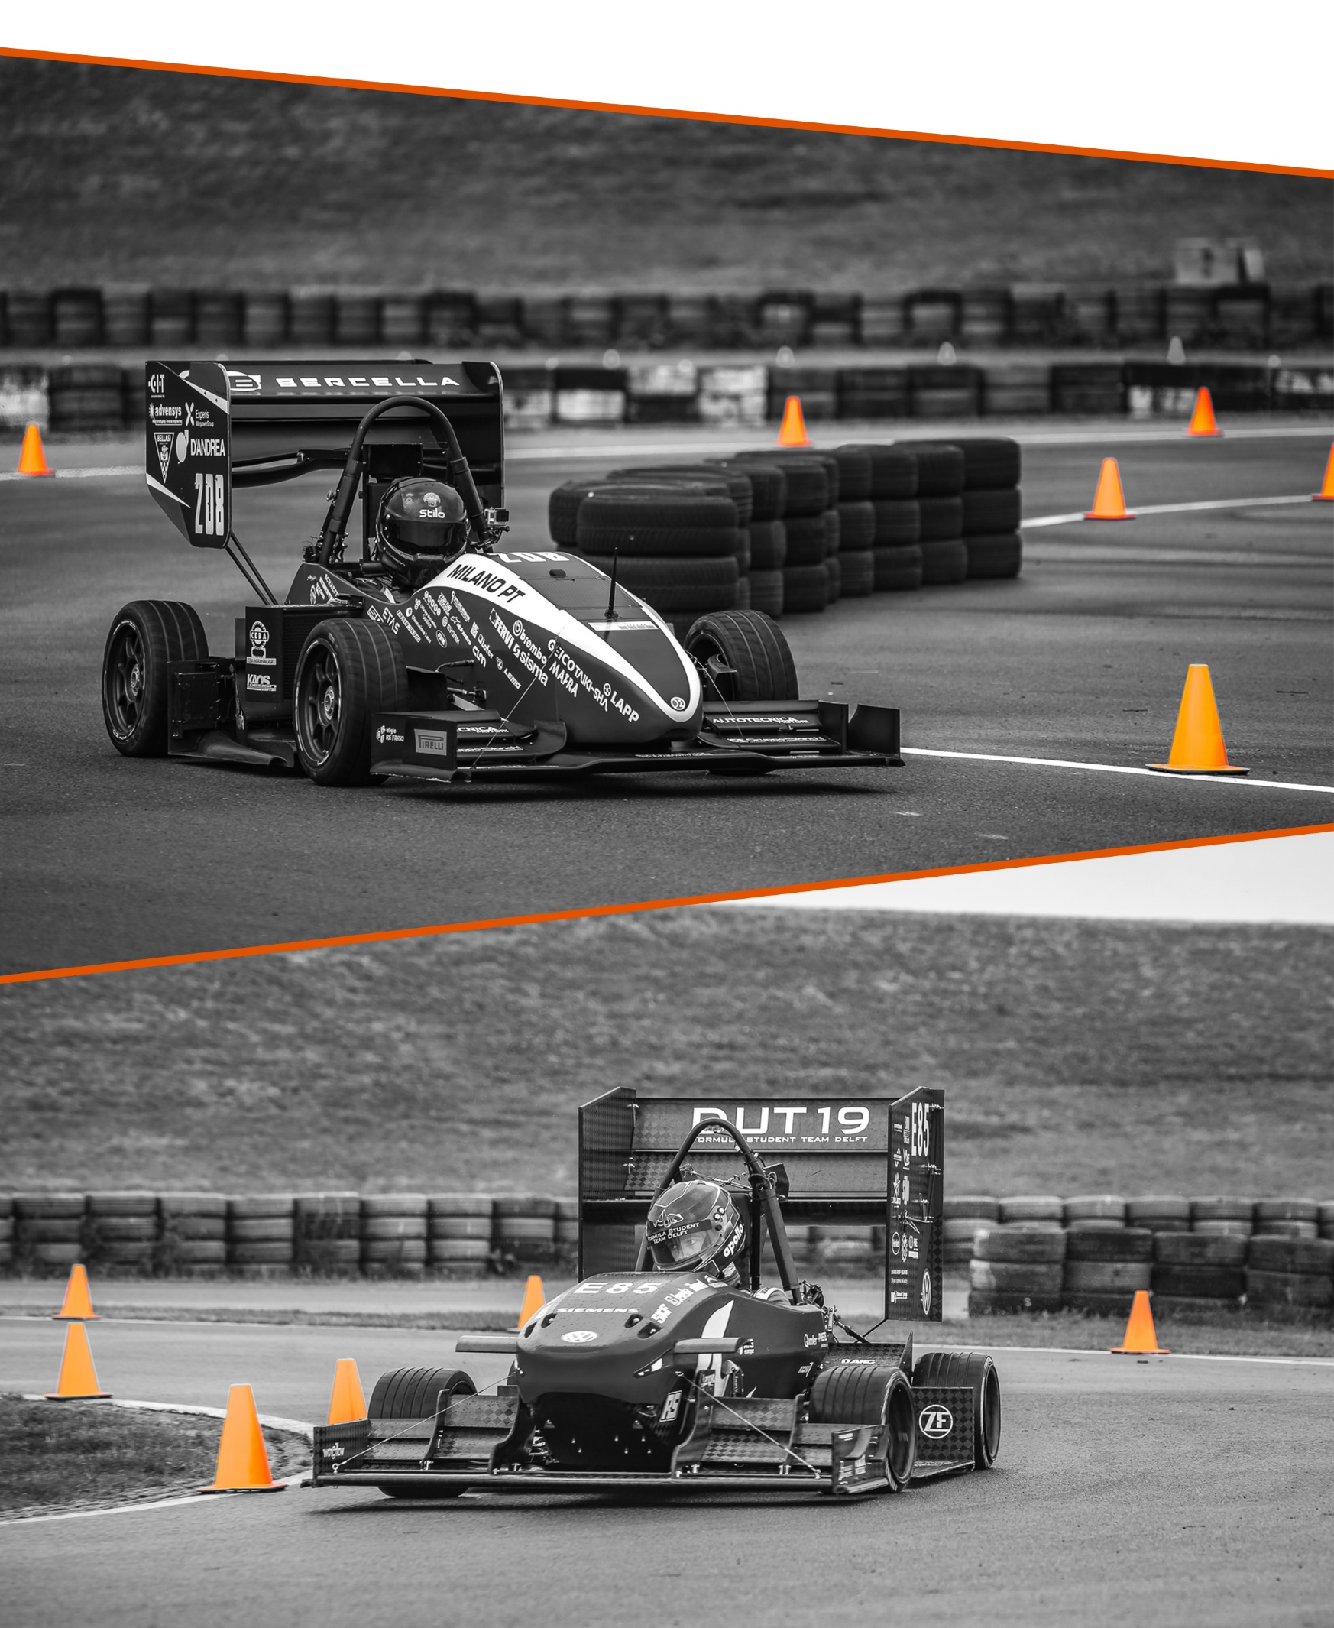
FORMULA STUDENT NETHERLANDS
DRIVER BRIEFING
JULY 6th 2021 | 12:00 CEST

Slide 2
AGENDA

Slide 3
General
2 drivers per team
(Rules D1.1.1 and D1.1.2 will be dropped)
No maximum amount of runs per driver
During endurance, you must switch drivers
Official Trackwalks:
Autocross Wednesday 12:00-13:00
Endurance Thursday 08:00-08:45

Slide 4
Skid Pad Event
Opening Times:
Tuesday 15:00-19:00
Wednesday 09:00-12:30
Skid Pad will be made wet regardless of weather conditions
Rain Tires
1 queue line

Slide 5
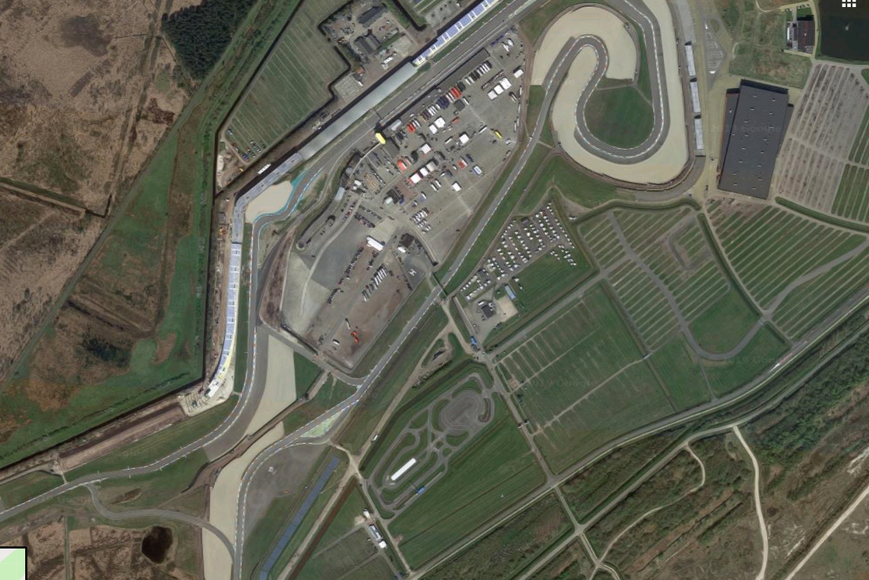
Skid Pad Event
Pit Garages
Opening Times:
Tuesday 15:00-19:00
Wednesday 09:00-12:30
Skid Pad will be made wet regardless of weather conditions
Rain Tires
Scrutineeirng
Skid Pad
Practice Area

Slide 6
Acceleration Event
Opening Times:
Wednesday 10:00-19:00
Location: Main Straight
1 queue
Warm up zone at the acceleration event
No burn-outs before start

Slide 7
Autocross Event
Opening Times:
Wednesday 13:30-19:00
Procedure:
Enter track
Pull up to green flag
After green flag is waved, start at your own convenience
After passing finish line -> enter pit
Left for immediate second run (minimum 1 minute waiting time for timing reasons)
Right for exit

Slide 8
Autocross Event
Pit Garages
Opening Times:
Wednesday 13:30-19:00
Procedure:
Enter track
Pull up to green flag
After green flag is waved, start at your own convenience
After passing finish line -> enter pit
Left for immediate second run (minimum 1 minute waiting time for timing reasons)
Right for exit
Scrutineeirng
Autocross
Practice Area

Slide 9
Endurance Event
Opening Times:
Thursday 09:30-16:30
Lunchbreak approx. 12:30-13:15
Running Order:
Start at 09:30 with reversed autocross result
Cars with no autocross result directly after lunchbreak
Procedure:
Enter track
Pull up to green flag
After green flag is waved, start at your own convenience
1st driver 11 laps, last lap sign after 10 laps. Finish flag after lap 11
Driver Change as per rules (3-minute)
2nd driver 11 laps, last lap sign after 10 laps. Finish flag after lap 11.
Proceed to immediate mechanical inspection at the exit of the Junior Track
CV Class cars will be escorted to fuel station for refuelling.
EV Class cars will be escorted to e-scrutineering area for electrical checks.

Slide 10
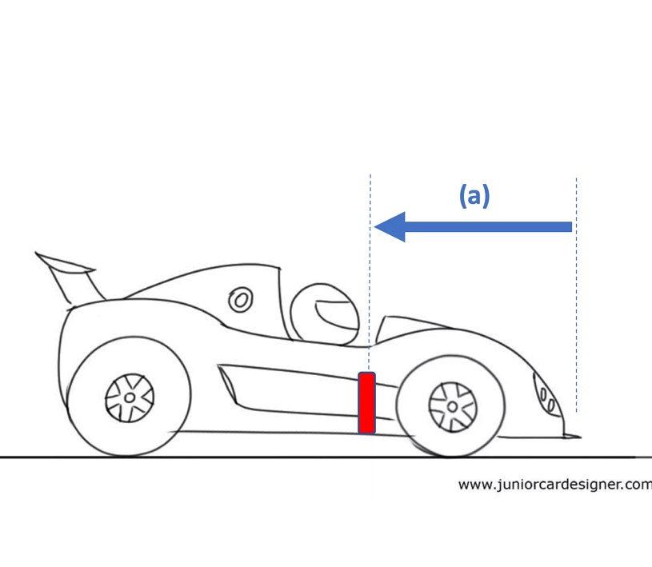
Transponders
Pick up from Welcome Centre
Black side down
Place on right side of vehicle, behind front suspension

